Slide 1
AdvPT Exercise 1

Slide 2
Content
Organization
Development environment
Memory management
Assignment_A

Slide 3
Organization
Time slot
Alternative time slot
Tuesday 12:15 - 13:45
Tuesday 14:15 - 15:45
Thursday 10:00 - 11:30
Thursday 12:15 - 13:45

Slide 4
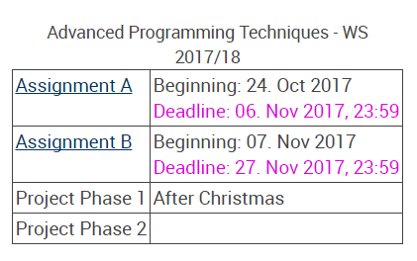
Assignment plan
Screenshot from Studon

Slide 5




Assignment plan
Two Assignments and one project

Slide 6
Building a C++ project
C++ compilers
GNU Compiler
Clang ( LLVM based )
Intel Compiler
Microsoft C/C++ Compiler (Visual studio)
IBM Compiler

Slide 7
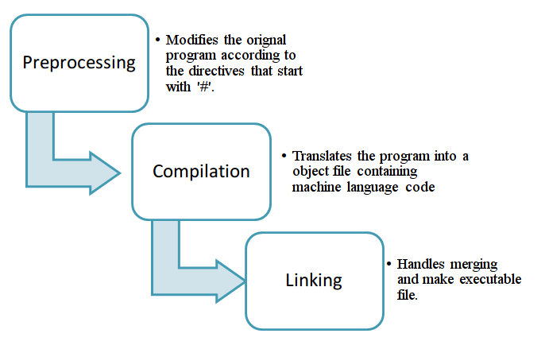
Building a C++ project

Slide 8
Building a C++ project
Compile Step:
g++ -c MySourceFile.cpp -o MySourceFile.o
Linking Step:
g++ MySourceFile.o MyOtherSourceFile.o -o myExecutable
Flag | Meaning
-c | Compile
-g | Include debug information
-O3 | Optimization Level 3 ( Levels from 1 to 3)
-DVAR=1 | Equivalent to “#define VAR 1”
-IMyIncludeDir | Add directory to search for includes
-LMyLibraryDir | Add directory to search for libraries
-lgreatFeature | Links agains libgreatFeature.a or libgreatfeature.so

Slide 9
Building a C++ project
Tasks of a build system
Search for available compiler
Handle dependencies - only rebuild parts that have changed
Assist with compile options (Debug/Release Mode)
Find libraries and generate according linking parameters
Handle installation/deployment
Integration of other tools ( test drivers, documentation generators)
Many build system available
autotools
Scons
Gradle
CMake
…

Slide 10
CMake
CMake because:
Cross platform: generates build files for various infrastructures
Well supported in modern IDEs
Powerful (platform independent) scripting language
CMake
UNIX Makefiles
Eclipse Projects
Visual Studio Solutions
Ninja
Kdevelop
…

Slide 11
C++ IDEs
Eclipse
CLion
QtCreator
Visual Studio

Slide 12
Memory management
Memory management
Pointors & References
Multidimentional structures

Slide 13
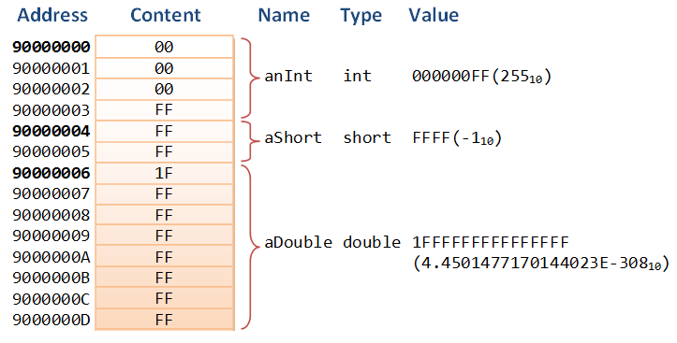
Pointor
memory: linear address space
C/C++ gives you the power (responsibility!) to access arbitrary memory regions
OS prevents access to certain memory regions (SEGFAULT)
Pointer store memory addresses

Slide 14
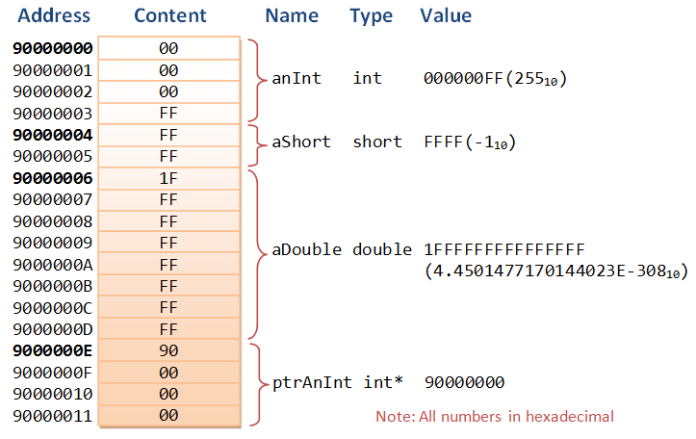
Pointor
memory: linear address space
C/C++ gives you the power (responsibility!) to access arbitrary memory regions
OS prevents access to certain memory regions (SEGFAULT)
Pointer store memory addresses

Slide 15
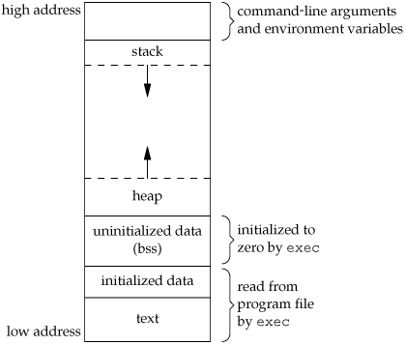
Memory region

Slide 16
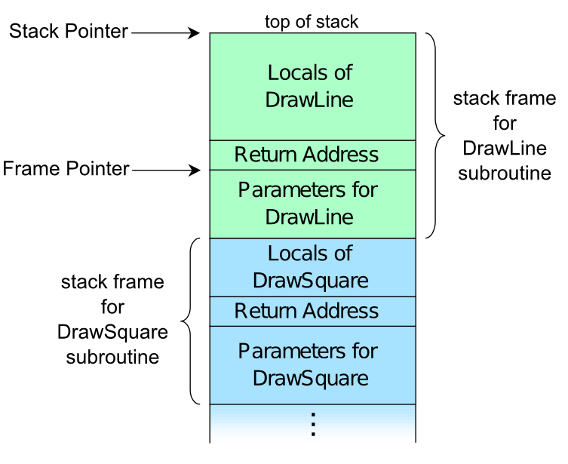
Stack

Slide 17
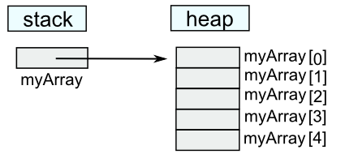
Heap
int * myArray = new int[5];

Slide 18
Memory Leaks
Memory which is no longer needed is not released.
int main( int argc, char**argv)
{
int * arr = 0;
arr = new int[20]; //Leak!!
return 0;
}

Slide 19
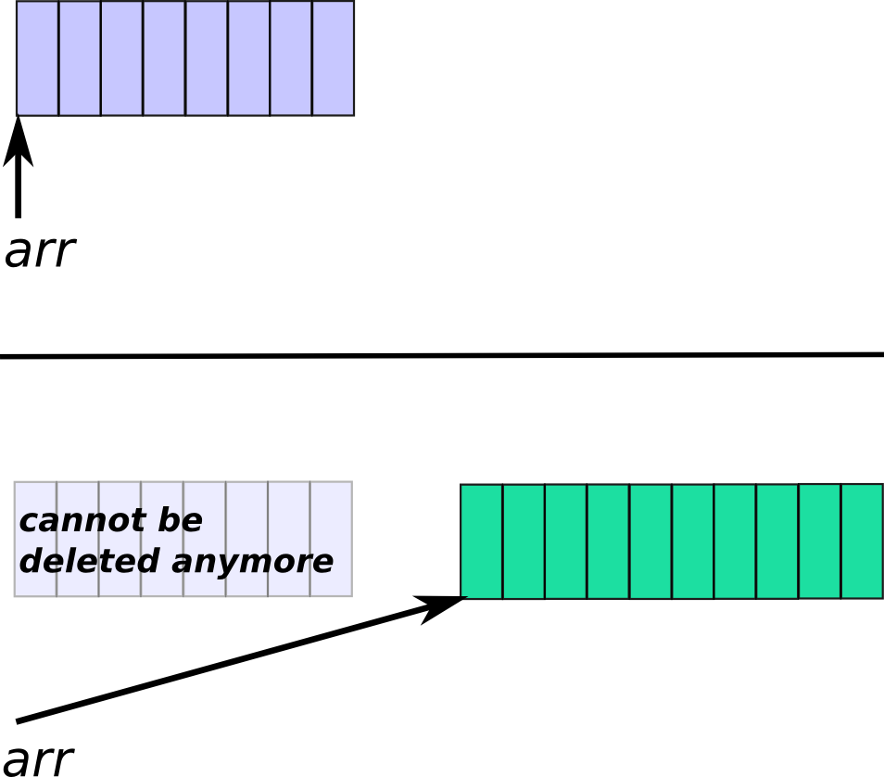
Common errors
int main( int argc, char**argv)
{
int * arr = 0;
arr = new int[20];
//do something with array, now larger array is needed
arr = new int[40];
delete [] arr;
}

Slide 20
Common errors
#include <iterator>
#include <iostream>
using namespace std;
int main( int argc, char**argv)
{
int arr1[3] = { 1, 2, 100 };
int arr2[2] = { 9, 8 };
for( int i=0; i<=2; ++i )
arr2[i] += arr1[i];
copy( arr1, arr1+3, ostream_iterator<int>(cout, "," ) );
cout << endl;
copy( arr2, arr2+2, ostream_iterator<int>(cout, "," ) );
cout << endl;
}

Slide 21
Common errors
int main( int argc, char** argv )
{
int * arr = new int [500];
for( int i=0; i<500; ++i )
arr[i] = 0;
delete arr;
}

Slide 22
Common errors
std::vector<int> & createUnitVector( int len )
{
std::vector<int> vec ( 3, 1 );
return vec;
}
int main( int argc, char** argv )
{
auto myVec = createUnitVector( 4 );
myVec[4] = 5;
return 0;
}

Slide 23
Rule of three
One special rule of thumb, which defines three special member functions:
Destructor
Copy constructor
Copy assignment operator
The Rule of Three claims that if one of these had to be defined by the programmer, i.e. the compiler-generated version does not fit the needs of the class in one case and it will probably not fit in the other cases either.
Example: Vector Class

Slide 24
Thank you and good luck!

